Slide 1
Confidence Intervals for Population Proportion

Slide 2
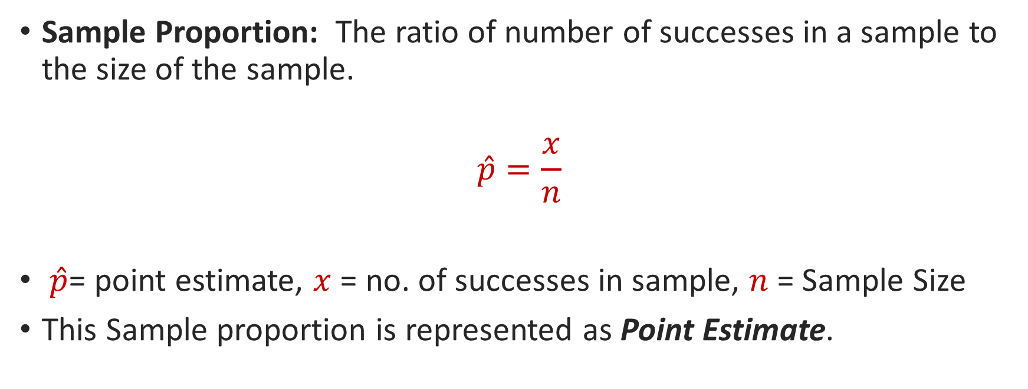
Confidence Intervals for Proportion in One Sample
Sample Proportion: The ratio of number of successes in a sample to the size of the sample.
$$\hat{p}=\frac{x}{n}$$
$\hat{p}$= point estimate, $x$ = no. of successes in sample, $n$ = Sample Size
This Sample proportion is represented as Point Estimate.

Slide 3
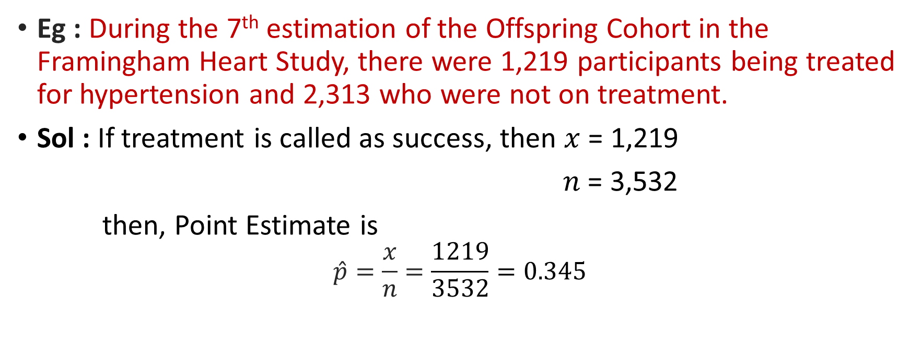
Confidence Intervals for Proportion in One Sample
Eg : During the 7th estimation of the Offspring Cohort in the Framingham Heart Study, there were 1,219 participants being treated for hypertension and 2,313 who were not on treatment.
Sol : If treatment is called as success, then $x$ = 1,219
$n$ = 3,532
then, Point Estimate is
$$\hat{p}=\frac{x}{n}=\frac{1219}{3532}=0.345$$

Slide 4
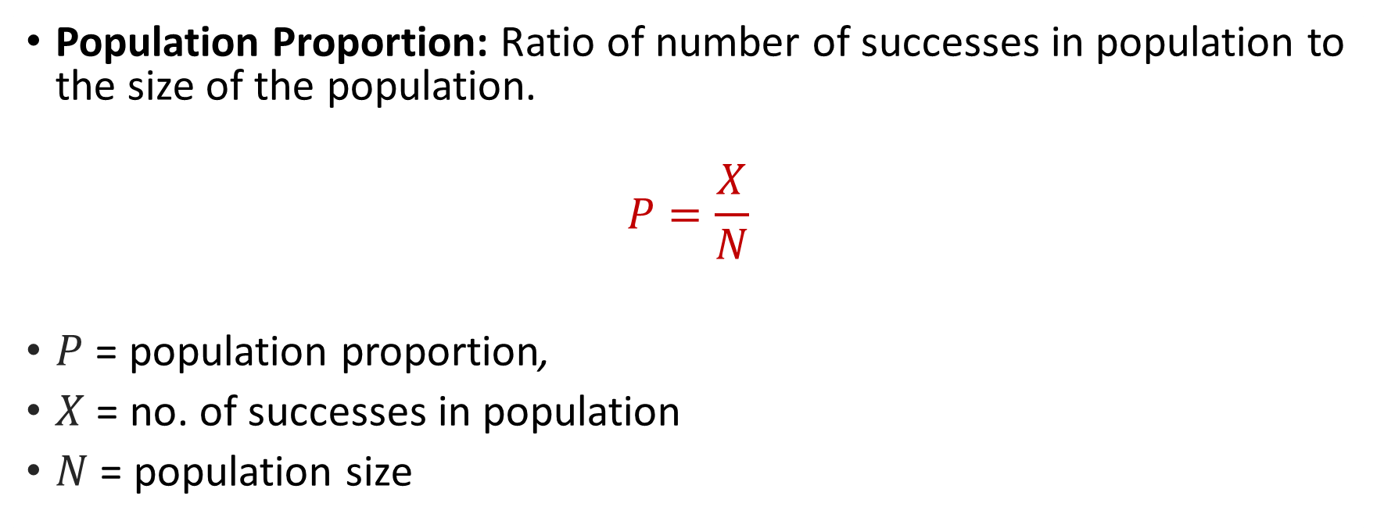
Confidence Intervals for Population Proportion
Population Proportion: Ratio of number of successes in population to the size of the population.
$$P=\frac{X}{N}$$
$P$ = population proportion,
$X$ = no. of successes in population
$N$ = population size

Slide 5
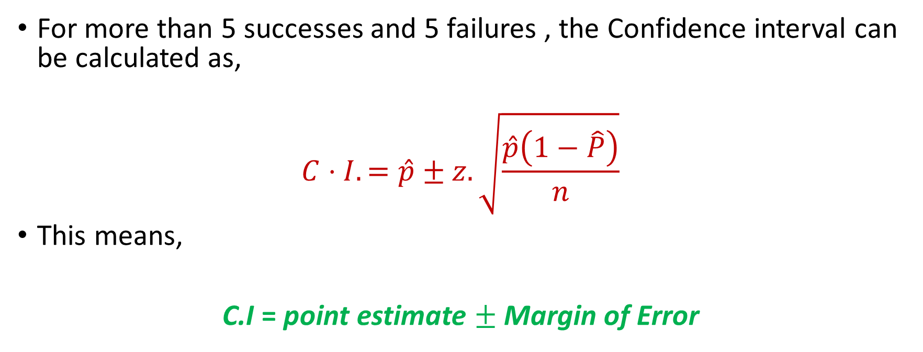
Confidence Intervals for Population Proportion
For more than 5 successes and 5 failures , the Confidence interval can be calculated as,
$$C⋅I.=\hat{p}±z.\sqrt{\frac{\hat{p}\left(1−\hat{P}\right)}{n}}$$
This means,
C.I = point estimate $±$ Margin of Error

Slide 6
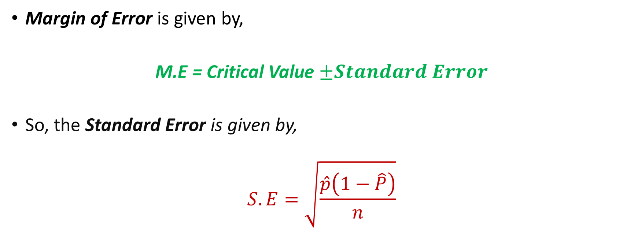
Confidence Intervals for Population Proportion
Margin of Error is given by,
M.E = Critical Value $±Standard Error$
So, the Standard Error is given by,
$$S.E=\sqrt{\frac{\hat{p}\left(1−\hat{P}\right)}{n}}$$

Slide 7
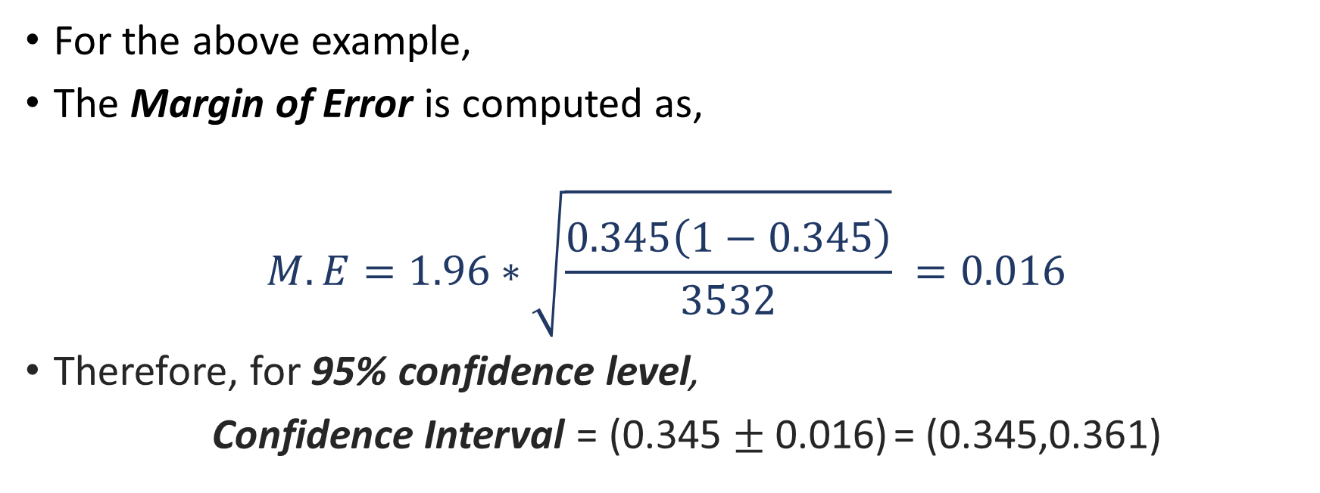
Confidence Intervals for Population Proportion
For the above example,
The Margin of Error is computed as,
$$M.E=1.96∗\sqrt{\frac{0.345\left(1−0.345\right)}{3532}} =0.016$$
Therefore, for 95% confidence level,
Confidence Interval = (0.345 $±$ 0.016) = (0.345,0.361)

Slide 8

Confidence Intervals for Variance $σ^{2}$and Standard Deviation $σ$

Slide 9
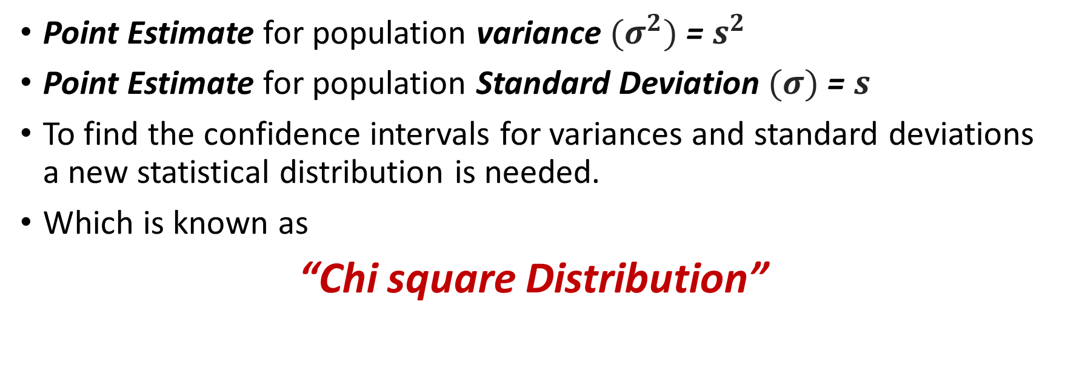

Confidence Intervals for Variance $σ^{2}$and Standard Deviation $σ$
Point Estimate for population variance ${(σ}^{2})$= $s^{2}$
Point Estimate for population Standard Deviation $(σ)$= $s$
To find the confidence intervals for variances and standard deviations a new statistical distribution is needed.
Which is known as
“Chi square Distribution”

Slide 10



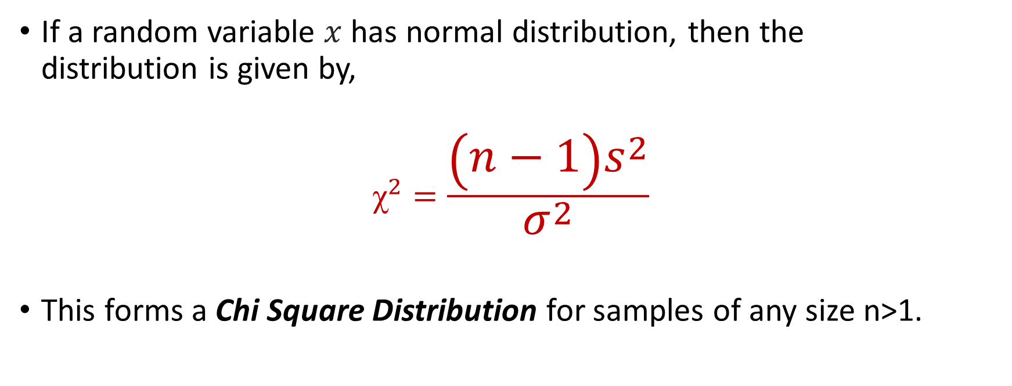

Chi square ${(ꭓ}^{2})$ Distributions
If a random variable $x$ has normal distribution, then the distribution is given by,
$$ꭓ^{2}=\frac{\left(n−1\right)s^{2}}{σ^{2}}$$
This forms a Chi Square Distribution for samples of any size n>1.

Slide 11
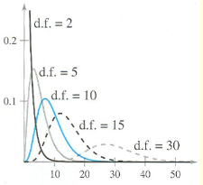


Chi square $( )$ Distributions
As the sample size (n) increases, the d.f. increases.
Then the curve becomes more symmetric when d.f.=100.
Gradually curve becomes flatter on further increase in d.f.

Slide 12
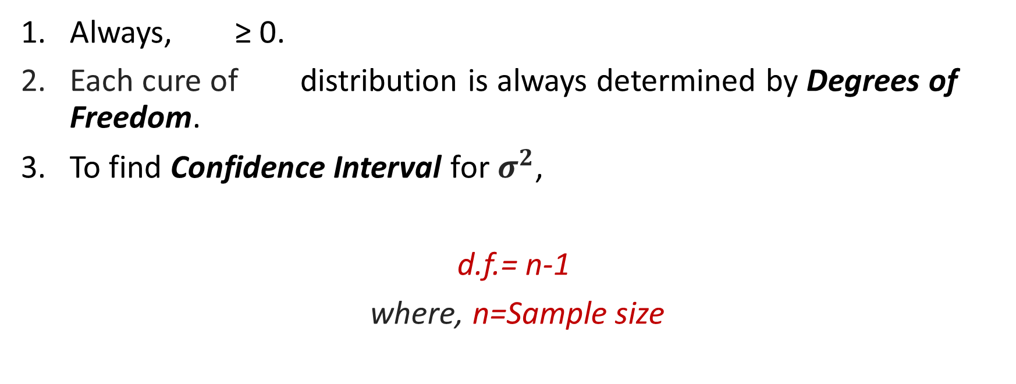
Properties
Always, $\text{≥ 0}$.
Each cure of distribution is always determined by Degrees of Freedom.
To find Confidence Interval for $σ^{2}$,
d.f.= n-1
where, n=Sample size

Slide 13
Properties
The area under each curve of Distribution is 1.
Distributions are Not Normal and Positively Skewed.
The distribution becomes somewhat symmetrical, approximately at 100 d.f.
Hence, the values for will be different on the right and left side of the distribution as it is not symmetric until 100 d.f. is nearly reached.

Slide 14


Critical Values
The Critical Values for -Distribution are represented as,
= Left-Critical Value
= Right-Critical Value
The following figures depicts the critical values of , various d.f. and areas of it

Slide 15




Critical Values
Areas under different tails of the curve:
$$1−\frac{\left(1−c\right)}{2}=\frac{\left(1+c\right)}{2}$$
Left Tailed Area
Right Tailed Area

Slide 16
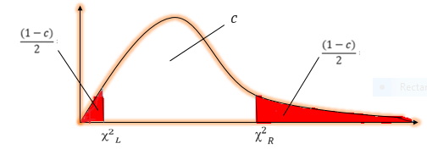
Critical Values
Two Tailed Curve Area
We can conclude that the area between both the tails is $c$.

Slide 17
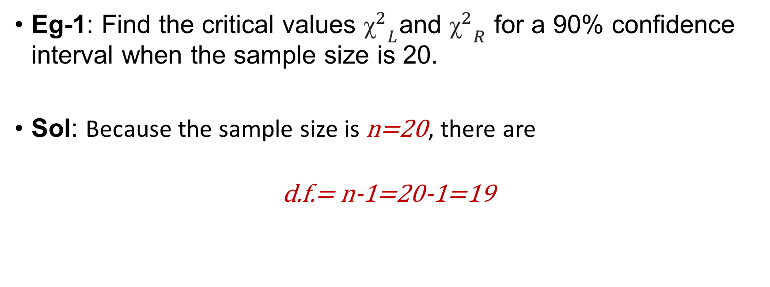

Finding Critical Values for $ꭓ^{2}$
Eg-1: Find the critical values ${ꭓ^{2}}_{L}$and ${ꭓ^{2}}_{R}$ for a 90% confidence interval when the sample size is 20.
Sol: Because the sample size is $\text{n}\text{=}\text{20}$, there are
$$\text{d}\text{.}\text{f}\text{.= }\text{n}\text{−}\text{1}\text{=}\text{20}\text{−}\text{1}\text{=}\text{19}$$

Slide 18


Finding Critical Values for $ꭓ^{2}$
Areas to the right side of ${ꭓ^{2}}_{L}$ and ${ꭓ^{2}}_{R}$ are,
Area to the right of ${ ꭓ^{2}}_{R}=\frac{\left(1−c\right)}{2}=\frac{\left(1−0.90\right)}{2}=0.05$
Area to the right of ${{ ꭓ}^{2}}_{L}=\frac{\left(1+c\right)}{2}=\frac{\left(1+90\right)}{2}=0.95$

Slide 19
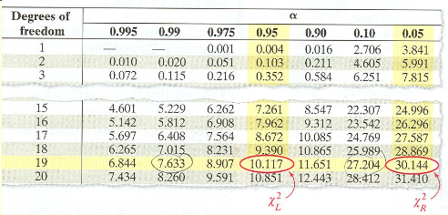

Finding Critical Values for $ꭓ^{2}$
Using $d.f.=19$ and the areas $0.95$ and $0.05$, we can find the critical values, as shown by the highlighted areas in the table.

Slide 20



Finding Critical Values for $ꭓ^{2}$
From the table,
${ ꭓ^{2}}_{R} = 30.114$
$${ ꭓ^{2}}_{L}= 10.117$$
So $90\%$ of the area under curve lie between $30.114$ and $10.117$

Slide 21
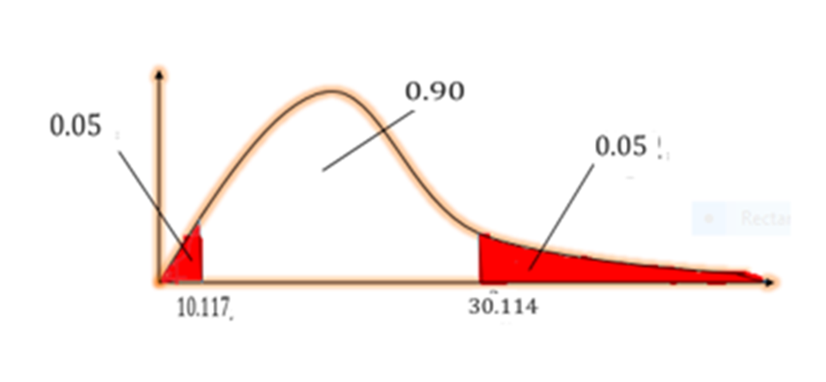
Finding Critical Values for $ꭓ^{2}$
Graph for the given problem

Slide 22
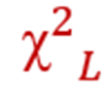


Definitions
C.I. For $σ^{2}$ and $σ$ :
$$\frac{\left(n−1\right)s^{2}}{{ ꭓ^{2}}_{R}}<σ^{2}<\frac{\left(n−1\right)s^{2}}{{ ꭓ^{2}}_{L}}$$
$$\sqrt{\frac{\left(n−1\right)s^{2}}{{ {}^{2}}_{R}}}<σ<\sqrt{\frac{\left(n−1\right)s^{2}}{}}$$

Slide 23
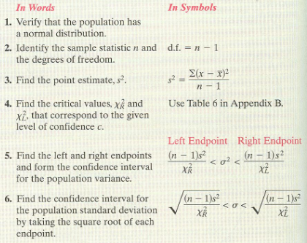
Key Points

Slide 24
Thank You

